Slide 1

JAVA TECHNOLOGIES
PROJECT PRESENTATION:
BONU PAVAN KUMAR
190101120054-CSE
POTNURU VARUN-
190101120046
CSE

Slide 2
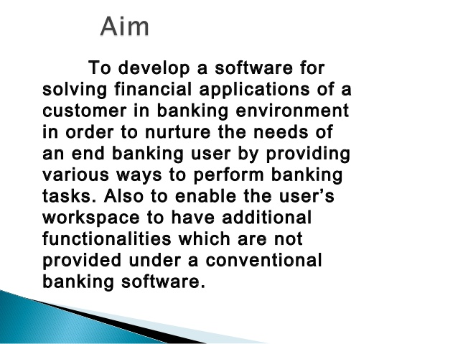
BANK MANAGEMENT SYSTEM PROJECT IN JAVA NETBEANS

Slide 3
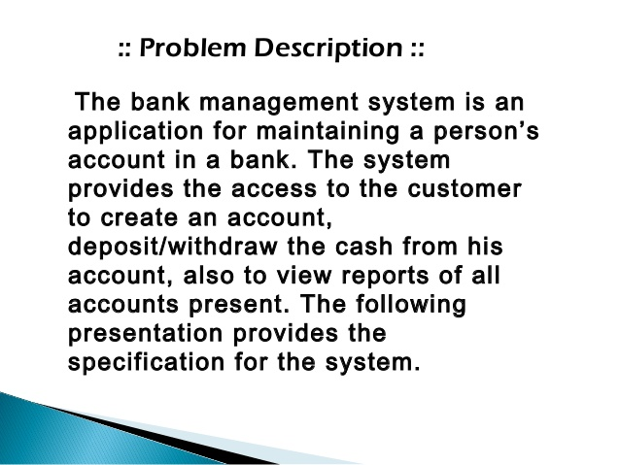

Slide 4
Bank management system project in java with source code and project report. Which contains all the required documents like ER diagram, DFD, Flow Chart of the bank management system.
Bank management project builds using Java as the core technology and J2ee, JSP, and HTML and front end, Servlet as a server-side language. following MVC and Maven tool to manage the dependency It using MYSQL and back-end to maintain the database records. Let’s see the required software, technology, and bank management project in java with a description in detail.

Slide 5
Objective of Online bank management project in java
The main objective is to create a web-based only system. which will help to maintain the bank account records, Maintain the transaction records of the customers. Easy to track all the banking activity a centralized system to maintain all the bank activity. Let’s check the project description with the role of different users.
This Project contains all the basic activities of the bank. there is 2 main actor.
➢Enter account holder name
➢Check balance
➢Deposit
➢Withdraw
➢exit

Slide 6
software requirements:
netbeans
java
notepad

Slide 7
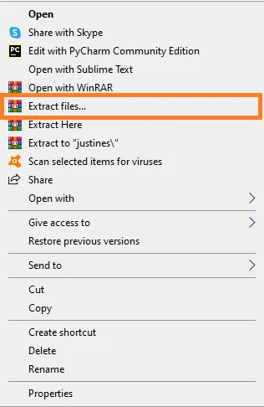
Extract file. Second, after you finished download the source code, extract the zip file.

Slide 8
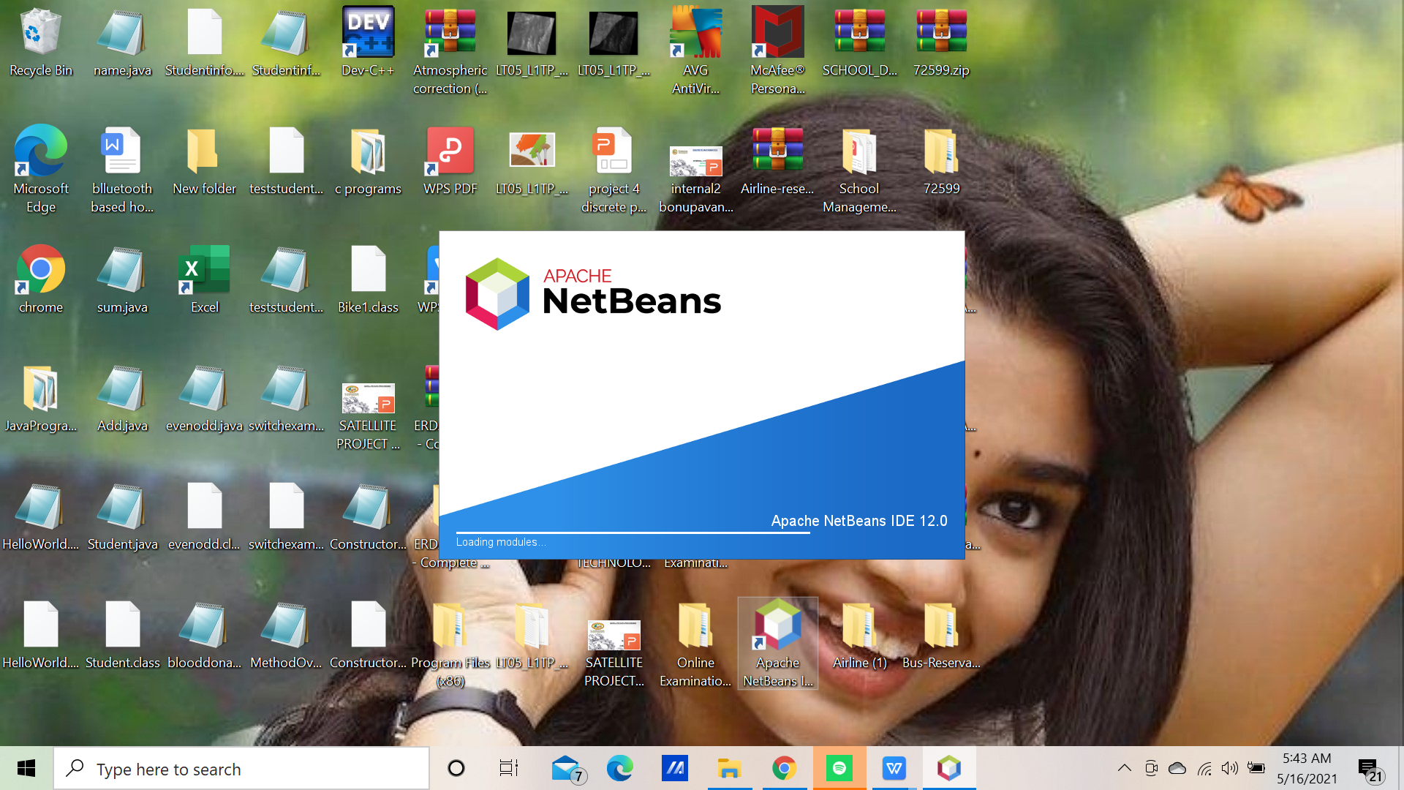
•Open Netbeans. Third, open “Netbeans IDE

Slide 9
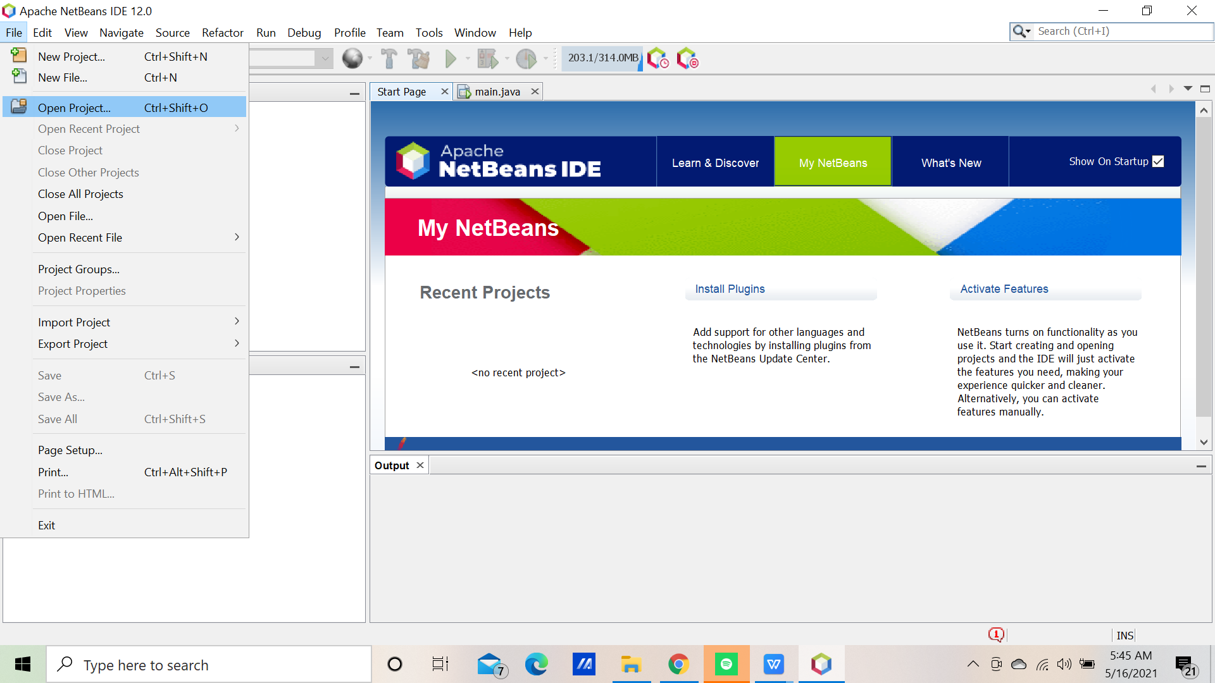
• Click open project. Fourth, click open project and choose your download source code

Slide 10
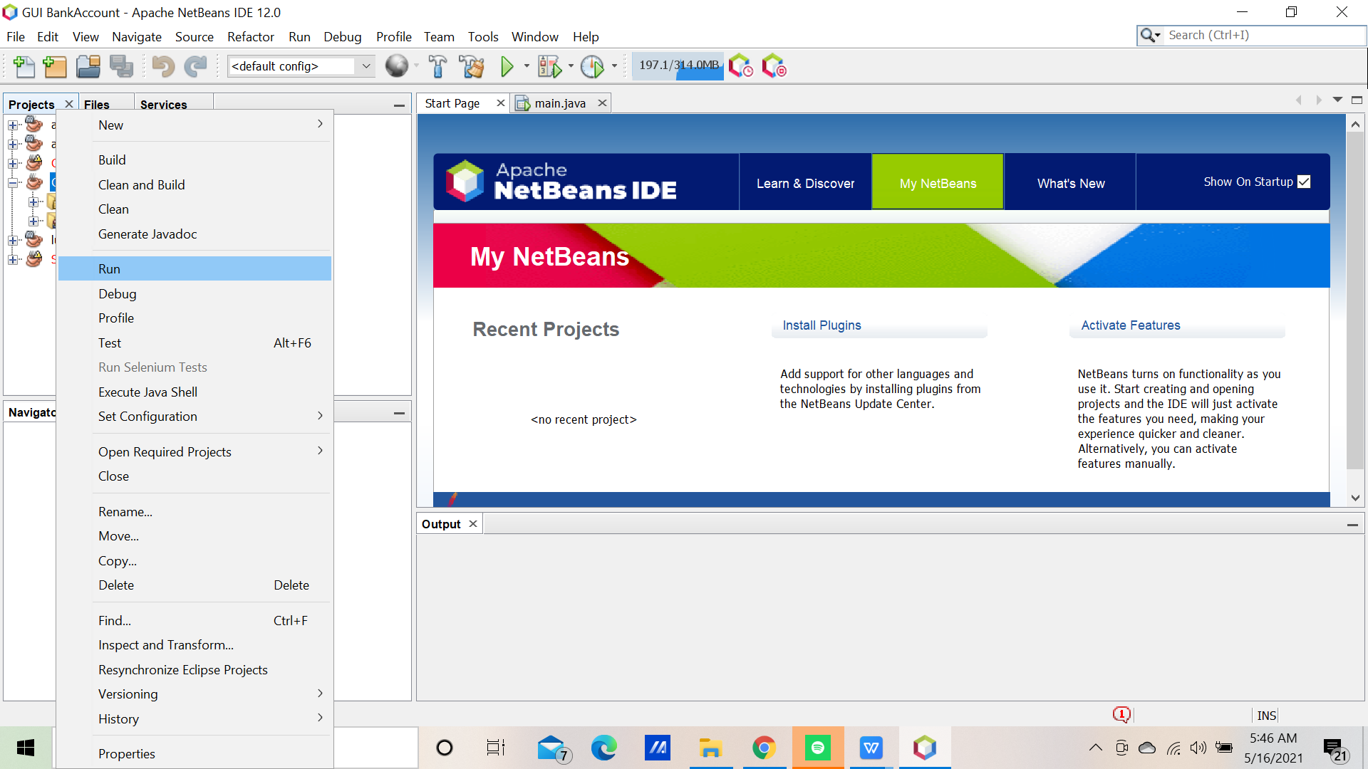
Step 5: Run the project.

Slide 11
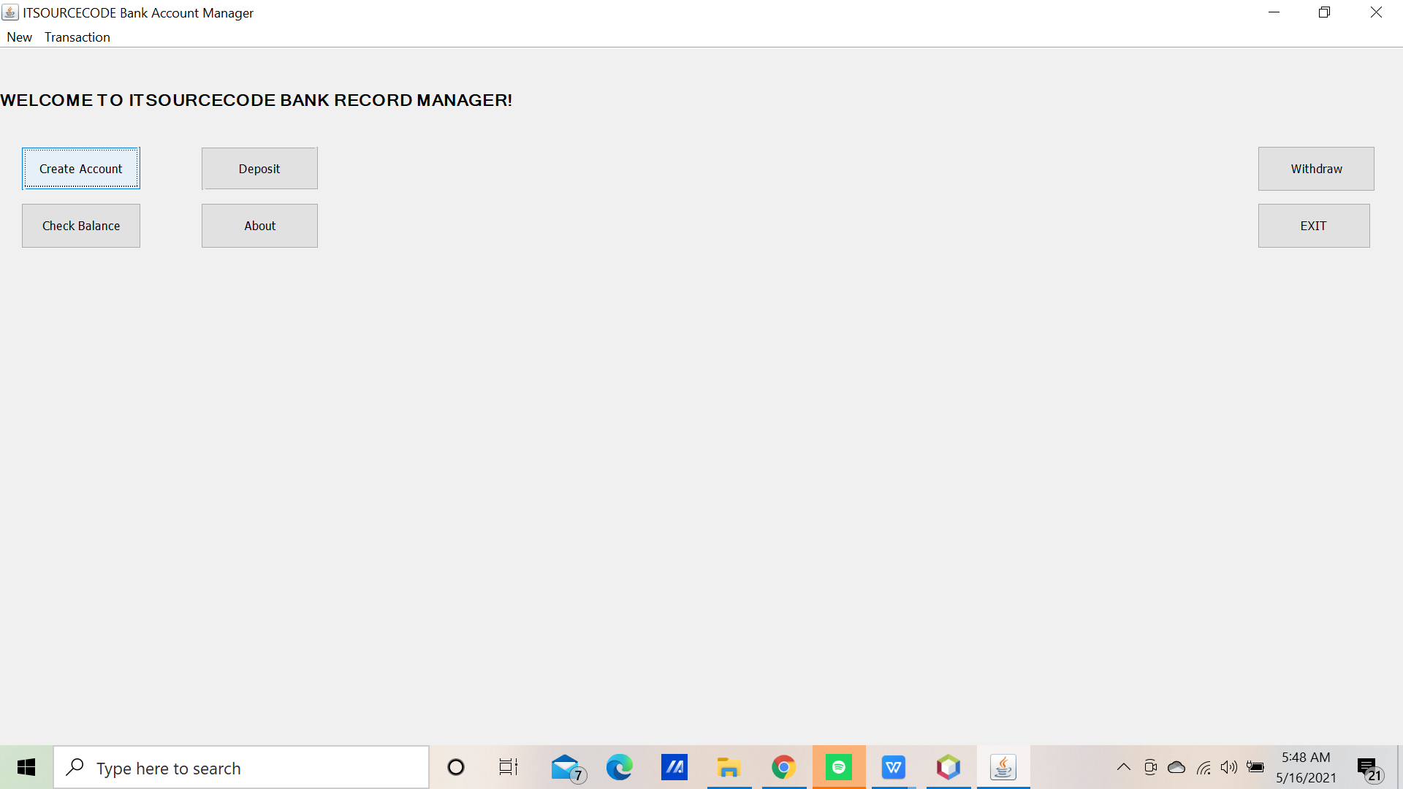
Step 6: The project design

Slide 12
PROGAMMING CODE
public void deposit(double amt) { balance = balance + amt; System.out.println("Amount Deposited."); } public void withdraw(double amt) throws BankAccountException { try { if(balance >= amt) { balance = balance - amt; System.out.println("Amount Withdrawn"); } else { throw new BankAccountException("Could not Withdraw: Insufficent Amount."); } } catch(BankAccountException bae) { bae.printStackTrace(); } } public void printBalance() { System.out.println("Current balance: " + balance); } public double getBalance() { return balance; } }
The Code Given Below Is For The Account Module: package BankAccount; public class Account { private double balance; private long accNum; private String accHolder; public Account(String name, long num) { accHolder = name; accNum = num; balance = 0.00; System.out.println("Account Created"); }

Slide 13
The Code Given Below Is For Creating Account Module;
String name;
long num;
name = JOptionPane.showInputDialog(null, "Please Enter Account Holder Name:", "Create Account", 1);
num = 1332522123;
acc = new Account(name, num);
JOptionPane.showMessageDialog(null, "Account Succesfully Created!", "Create Account", 1);
The Code Given Below Is For Deposit Module:
try
{
String num;
num = JOptionPane.showInputDialog(null, "Enter a Value To Deposit:", "Deposit Amount", 1);
double num1 = Double.parseDouble(num);
acc.deposit(num1);
}
catch(NumberFormatException | NullPointerException nfe1)
{
JOptionPane.showMessageDialog(null, nfe1, "Error", 2);
}

Slide 14
The Code Given Below Is For The Withdraw Module
try
{
String num;
num = JOptionPane.showInputDialog(null, "Enter a Amount To Withdraw:", "Withdraw Amount", 1);
double num1 = Double.parseDouble(num);
acc.withdraw(num1);
}
catch(BankAccountException | NumberFormatException | NullPointerException ex)
{
JOptionPane.showMessageDialog(null, ex, "Error", 2);
}
The Code Given Below Is For Check Balance Module
try
{
double num = acc.getBalance();
JOptionPane.showMessageDialog(null, "Current Balance: " + num, "Current Balance", 1);
}
catch(NullPointerException npe)
{
JOptionPane.showMessageDialog(null, npe, "Error", 2);
}

Slide 15
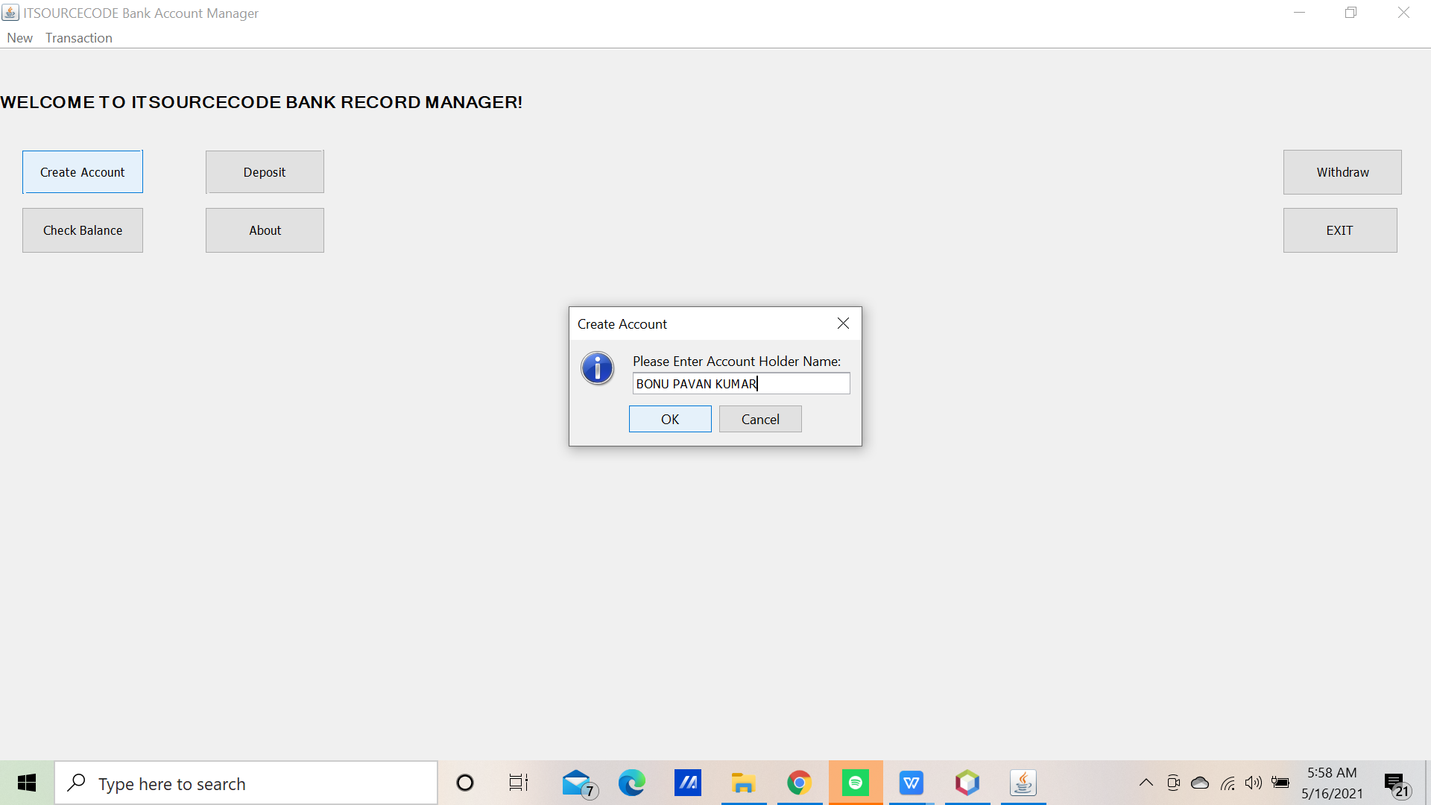
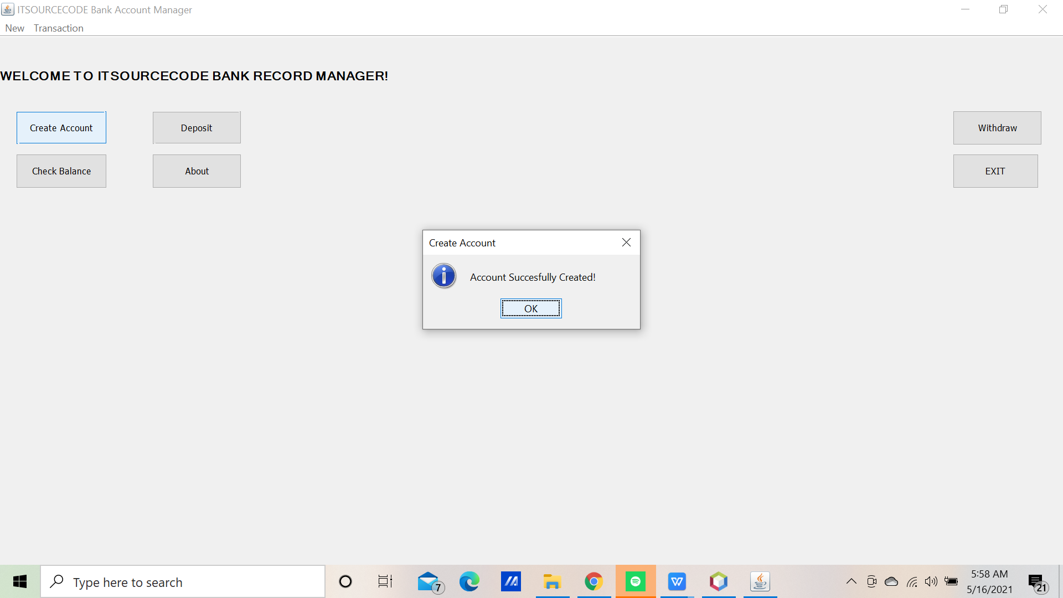
Outputs:

Slide 16
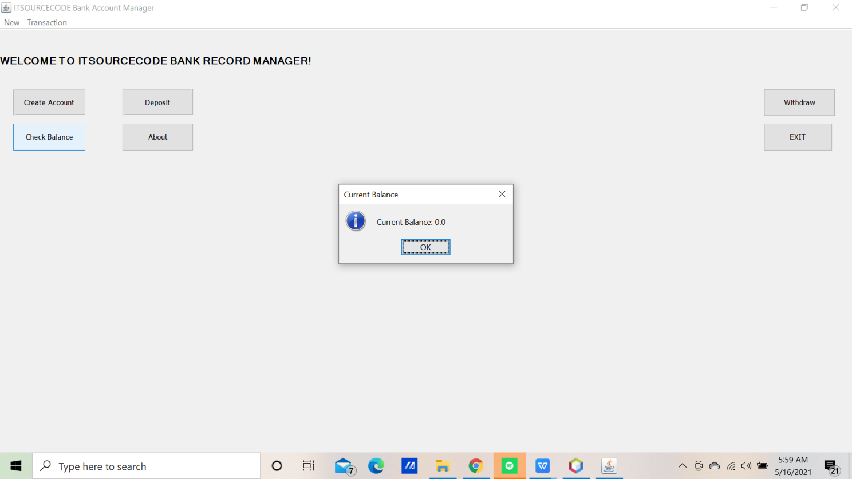
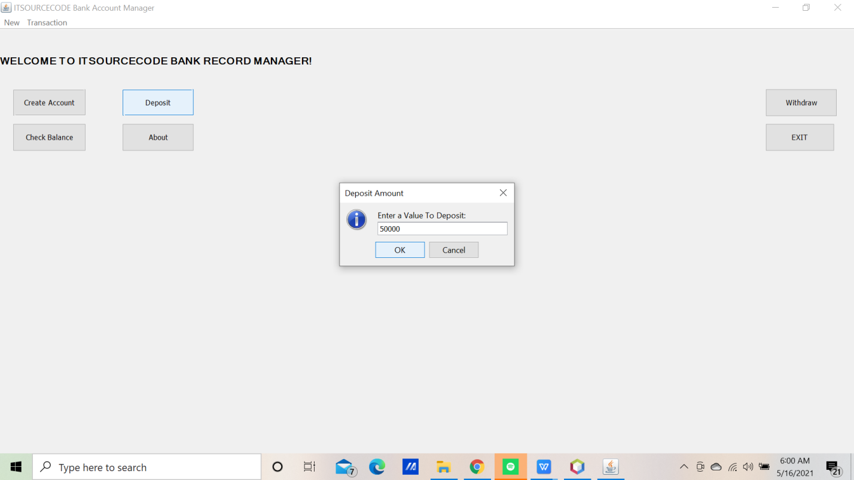

Slide 17
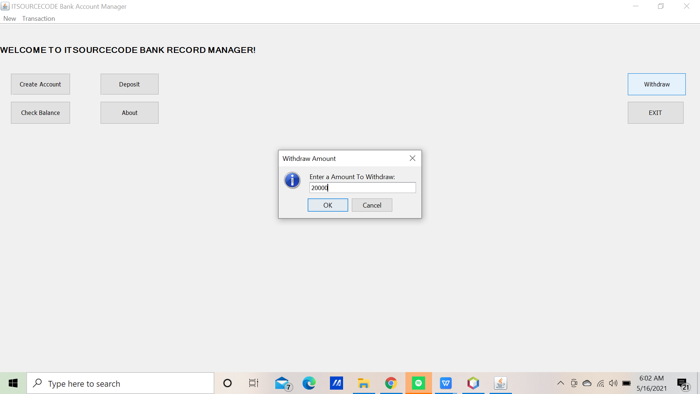


Slide 18
Limitations
Bank management system project in java with source code and project report. Which contains all the required documents like ER diagram, DFD, Flow Chart of the bank management system. Bank management project builds using Java as the core technology and J2ee, JSP, and HTML and front end, Servlet as a server-side language
Conclusion This project is developed to nurture the needs of a user in a banking sector by embedding all the tasks of transactions taking place in a bank. Future version of this software will still be much enhanced that the current version 1.0 thus the bank management system it is developed and executed successfully.it is helpful to create account details and money details. people .

Slide 19
THANK YOU

